Slide 1
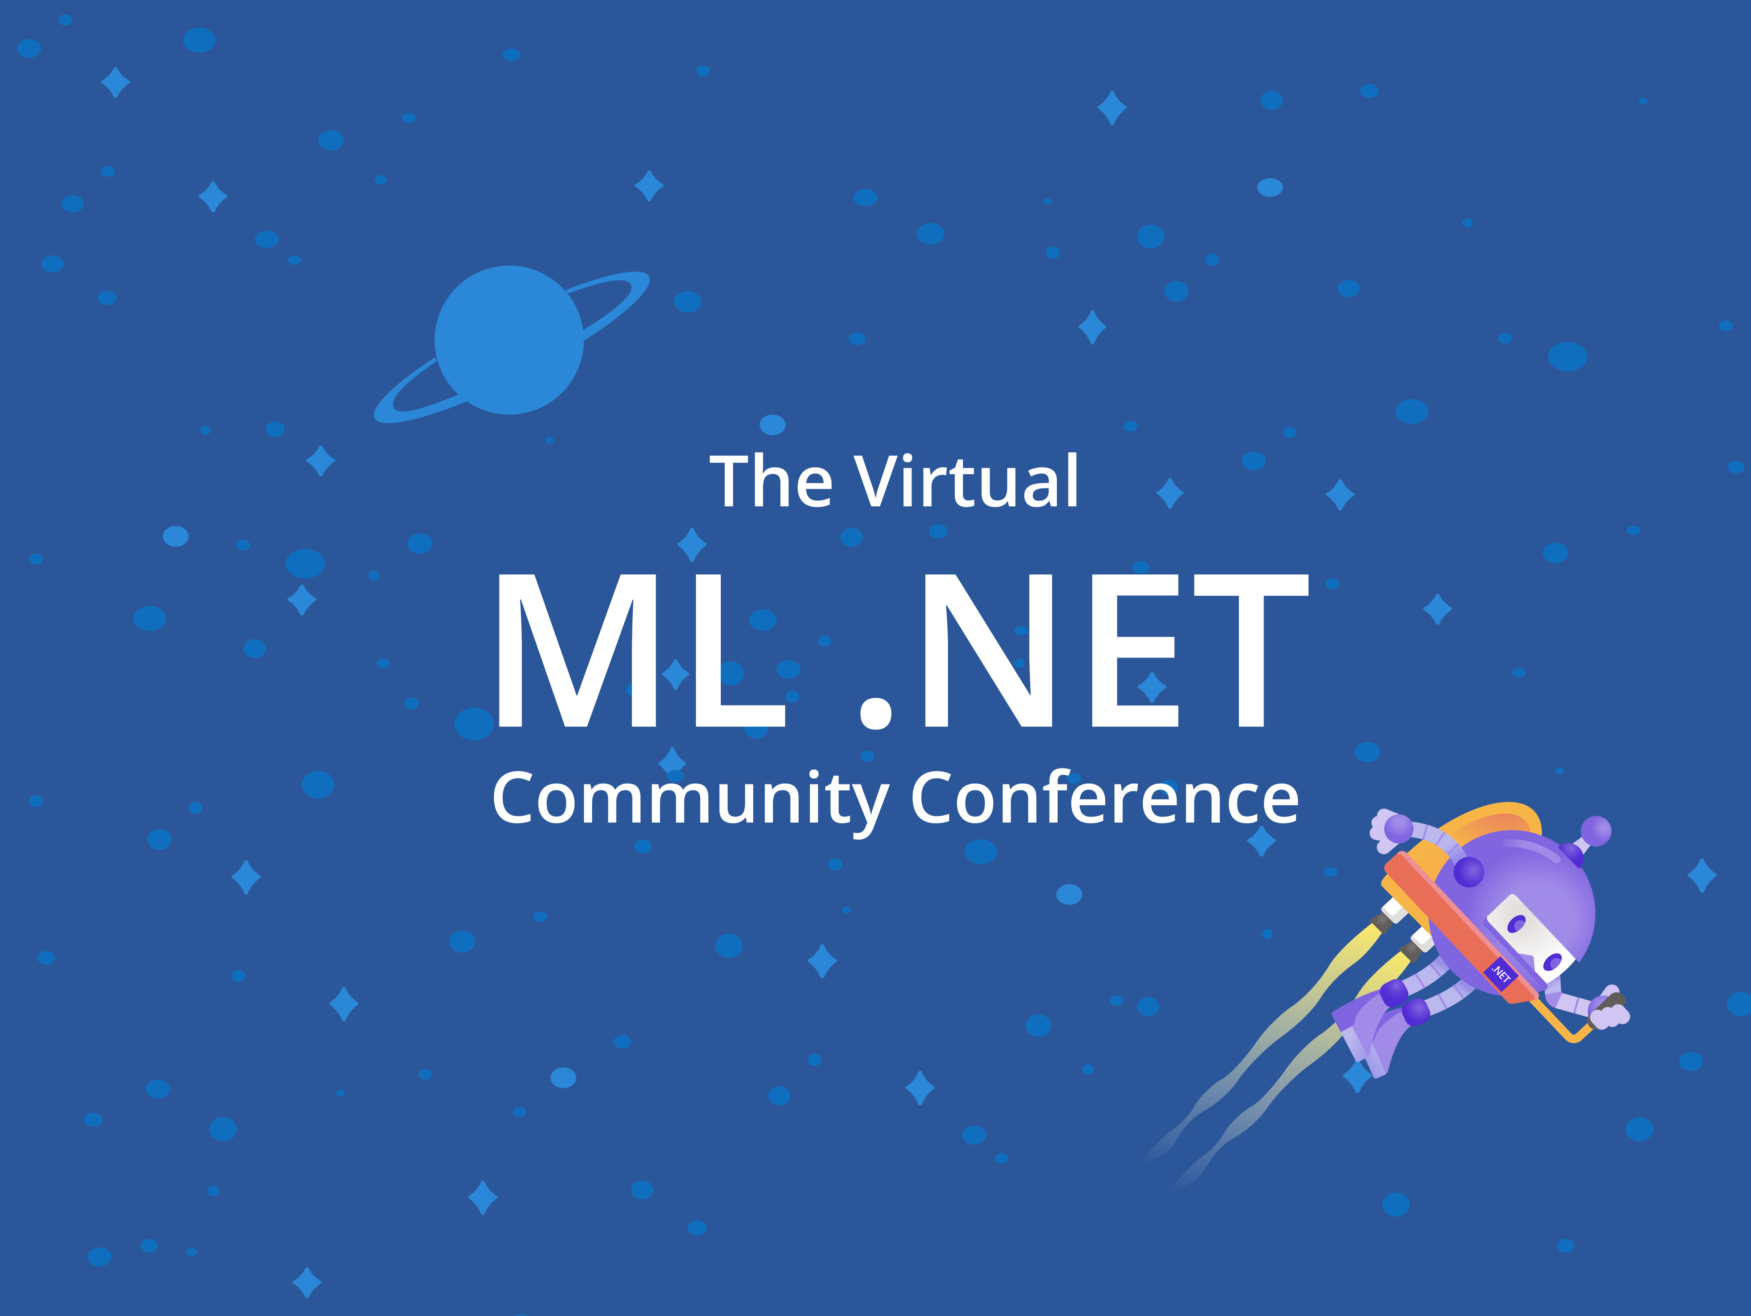
Training Workshop

Slide 2



Who are we?
Bri Achtman
Luis Quintanilla
Program Manager
@ Microsoft, ML.NET
Content Developer
@ Microsoft, ML.NET

Slide 3
Format
Streaming on Twitch and YouTube
Learn first, perform task & build app second
Ask questions via Twitch, YouTube, or the Slack channel (aka.ms/virtualmlnet-slack)

Slide 4
What is Machine Learning?
What is ML.NET?
ML.NET Challenge
Set up for ML.NET
Data
Train
Evaluate
Save model
Consume model
Deep learning
MLOps
Wrap up: Roadmap, Resources, Final Q&A
Agenda

Slide 5
Pre-reqs
aka.ms/mlnet-prereqs
Clone the project repo: aka.ms/mlnet-workshop
Windows
macOS or Linux
Visual Studio 2019 16.6 with .NET Core workload installed aka.ms/download-vs
Model Builder Preview Feature enabled in VS
VS Code or another code editor
aka.ms/download-vs
.NET Core 3.1 SDK
dotnet.microsoft.com/download
ML.NET CLI
aka.ms/mlnet-cli-install
.NET Core 2.1 SDK
aka.ms/download-netcore-21

Slide 6
Phase 1.0 What is Machine Learning?

Slide 7
Artificial Intelligence
Artificial Intelligence
The ability of a computer to perform tasks commonly associated with intelligent beings (reason, discover meaning, generalize, learn from past experience)
Typically starts as rule or logic-based system
Traditional AI techniques can be difficult to scale
Phase 1.0
Notes:
AI = machines imitating human abilities and behaviors

Slide 8
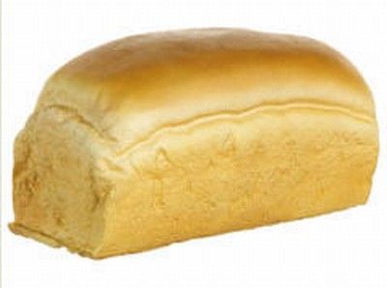

Artificial Intelligence
if(profileImage) {
if(isRectangular) {
if(topIsRound) {
if(hasEars) {
return false;
}
else if (hasEyes) {
return false;
}
else {
return true;
}
}
}
}
Bread
or
not bread?
Phase 1.0
Insert a bunch of if-else statements here to show that not scalable – insert MACHINE LEARNING

Slide 9
Machine Learning
Machine Learning
Getting computers to make predictions without being explicitly programmed
Computers find patterns in data and learn from experience to act on new data
Used to solve problems that are difficult or impossible to solve with rules-based programming
Phase 1.0

Slide 10
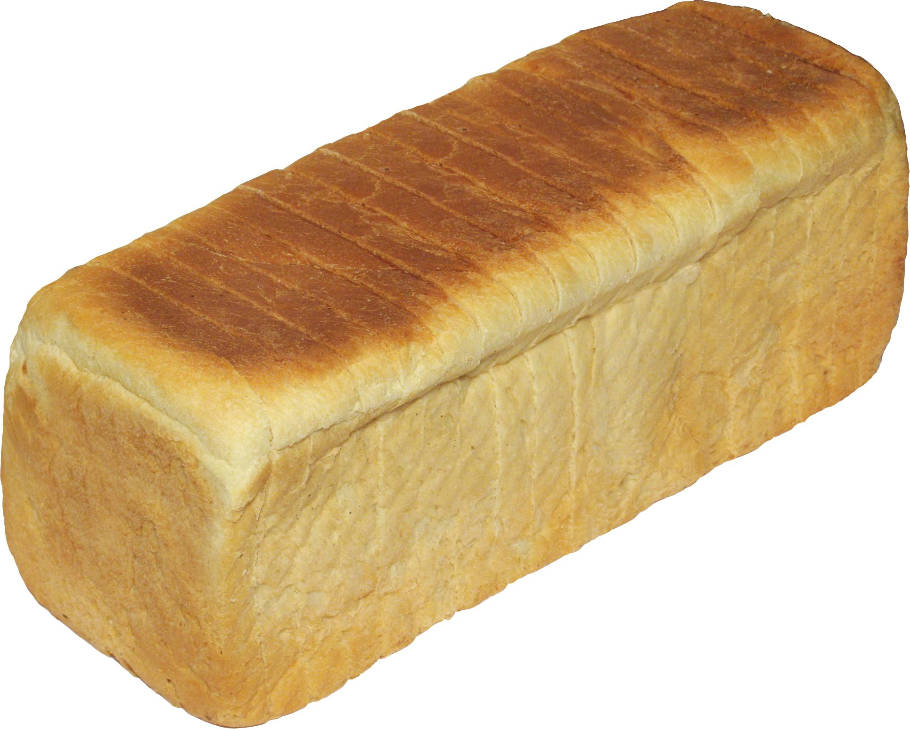
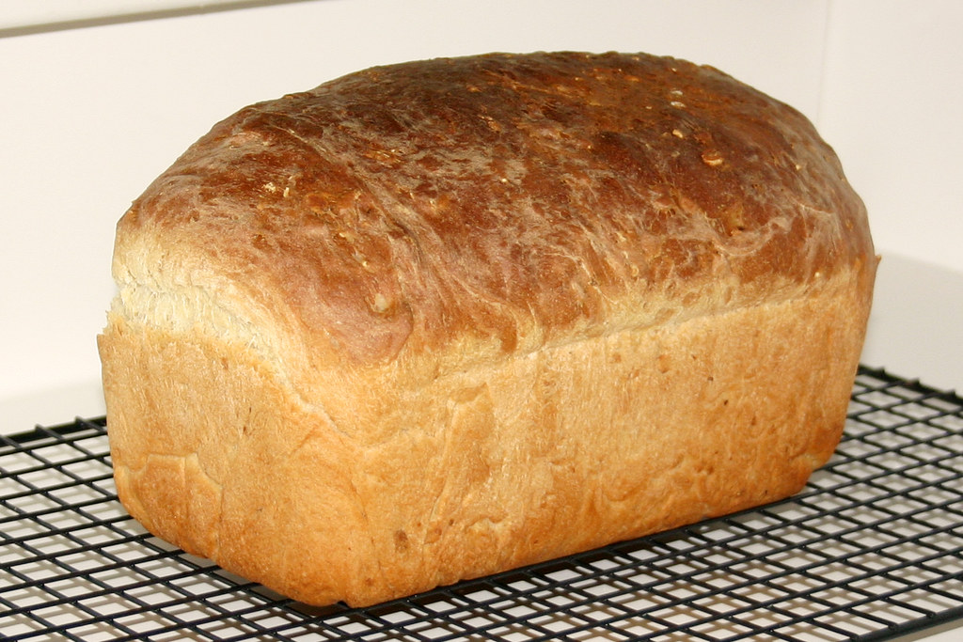
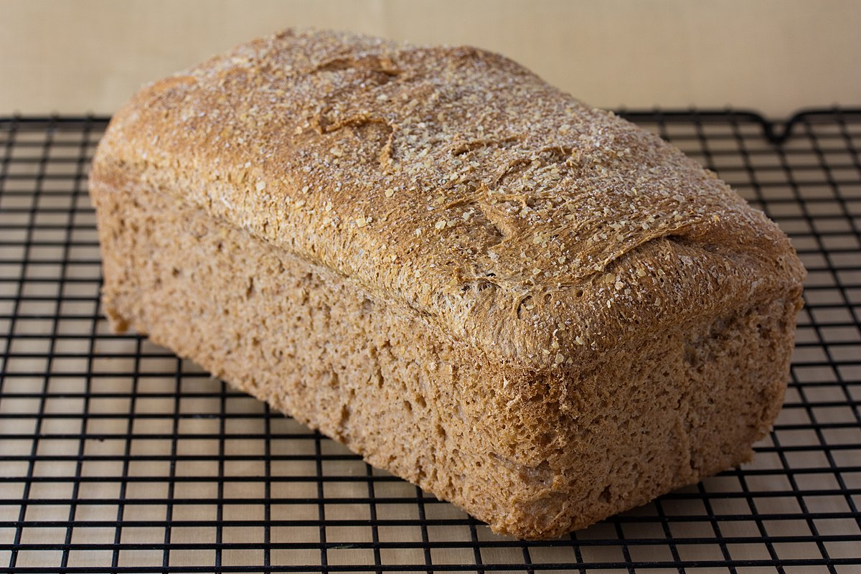
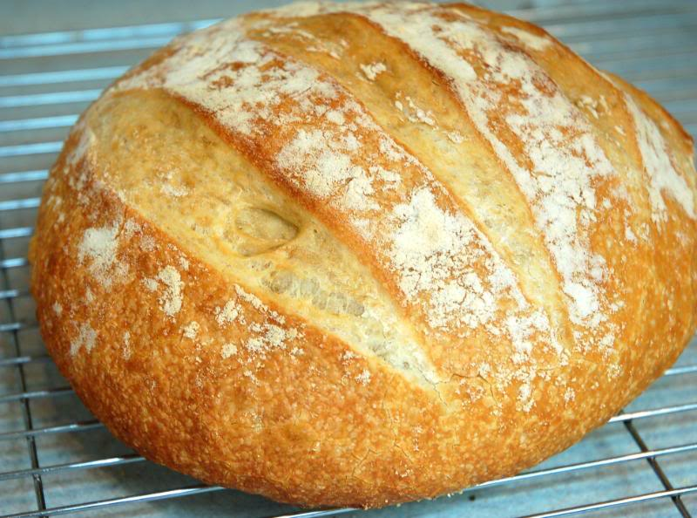
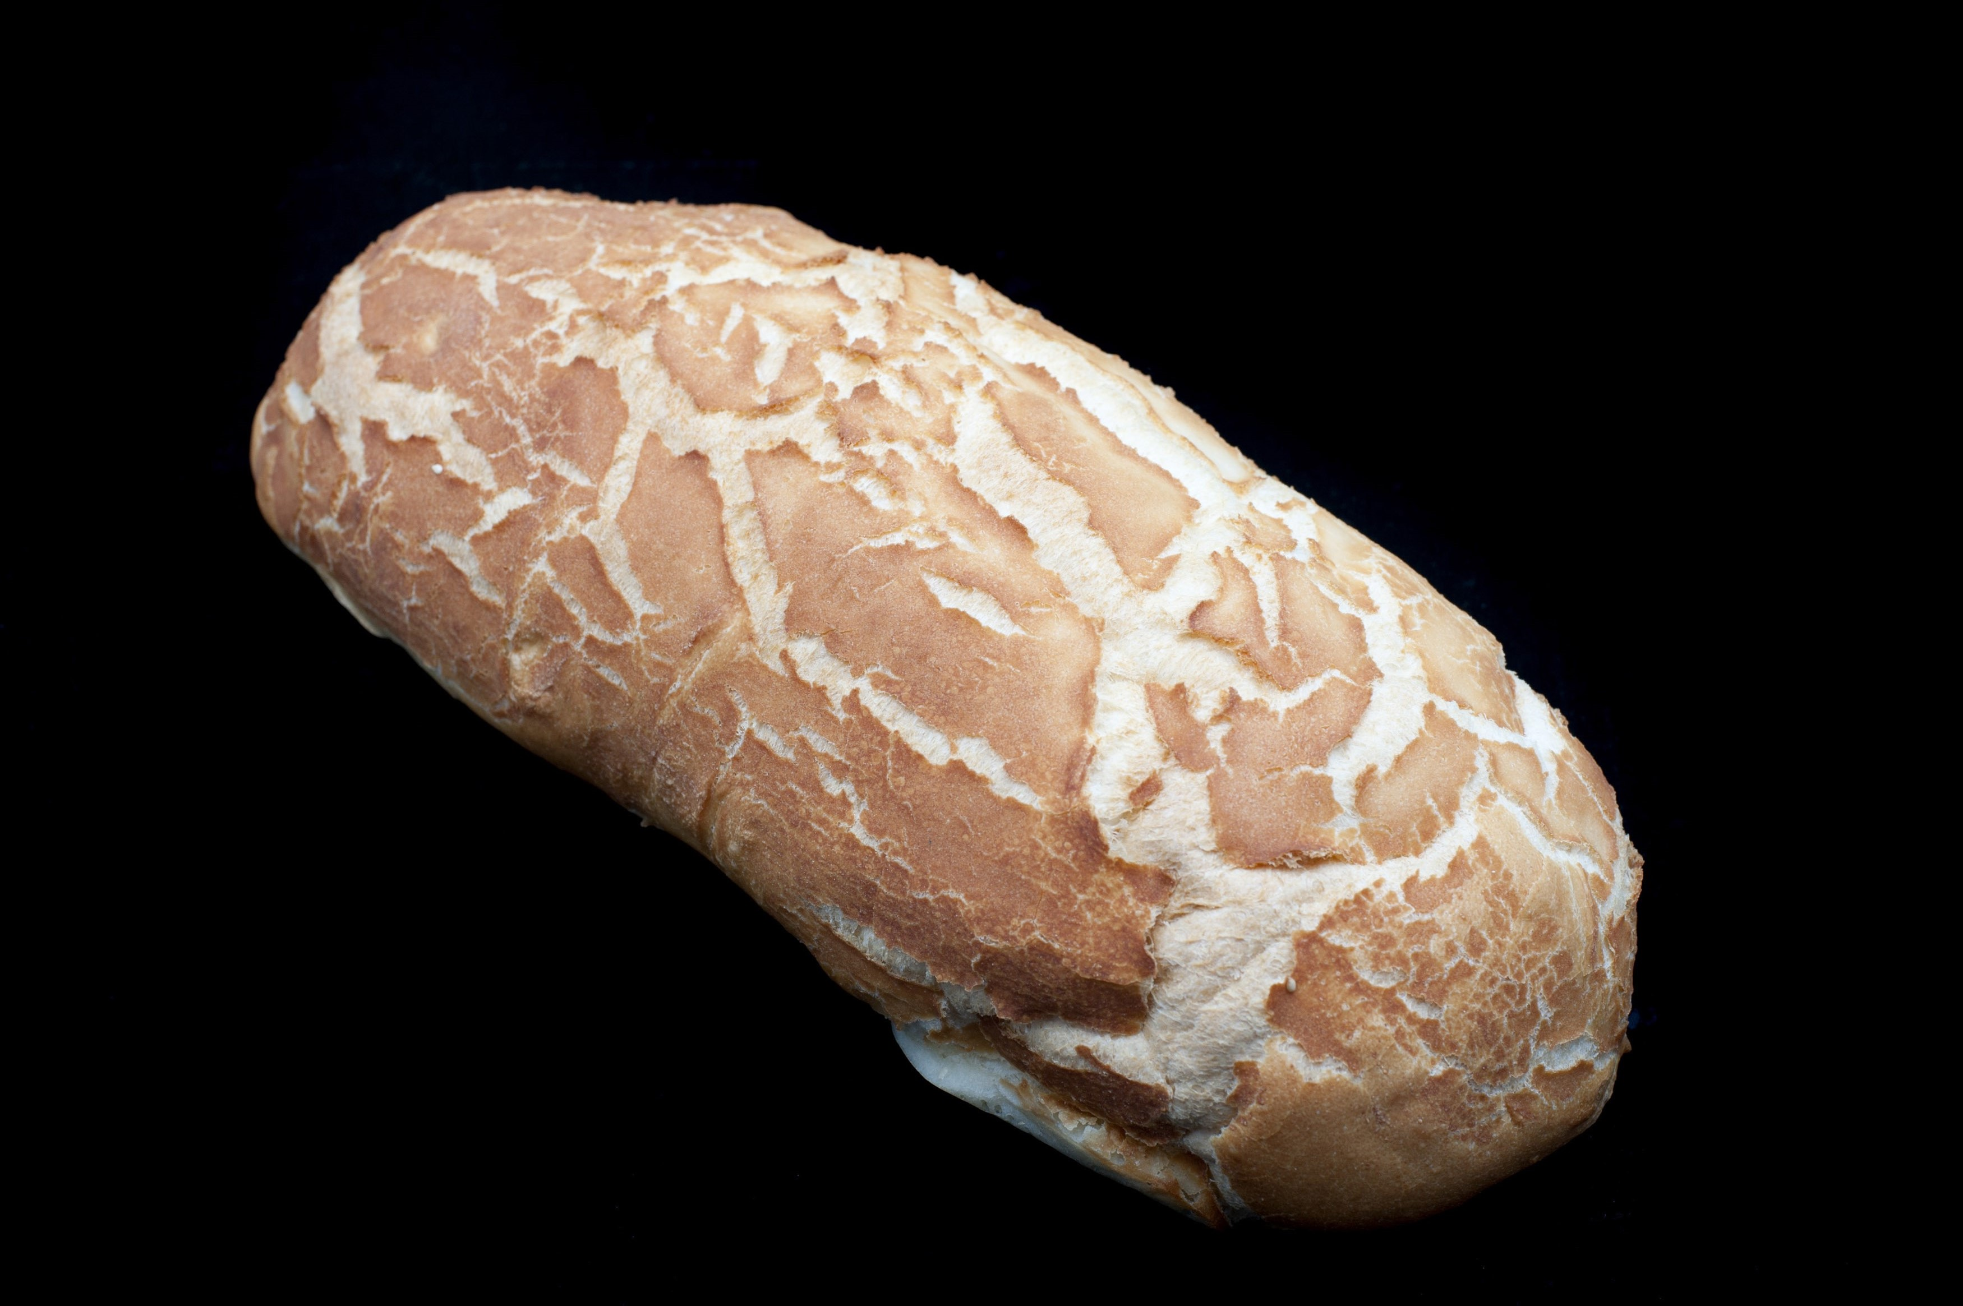


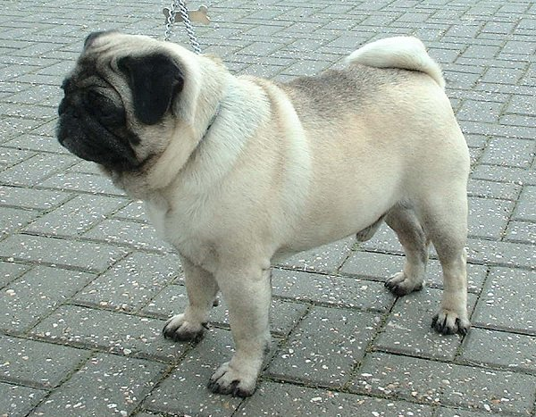
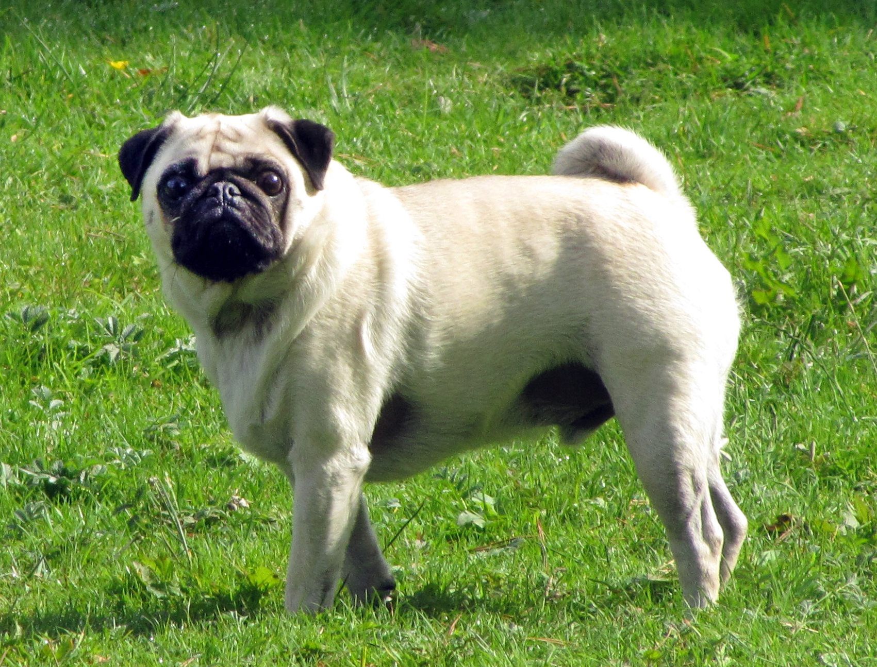



Machine Learning
Bread
Bread
or
not bread?
Not bread
Phase 1.0
Insert a bunch of if-else statements here to show that not scalable – insert MACHINE LEARNING

Slide 11
Artificial Intelligence vs. Machine Learning
Artificial Intelligence
Rules
Answers
Data
Machine Learning
Data
Rules
Answers
Phase 1.0

Slide 12
Deep learning
Deep Learning
Subset of ML based on artificial neural networks which imitate the way the human brain learns, thinks, and processes data.
Neural networks form many layers
Scenarios include image classification, object detection, speech recognition, NLP
Phase 1.0

Slide 13
AI + ML + Deep learning
Artificial Intelligence
Machine Learning
Deep
Learning
Phase 1.0

Slide 14
Mapping business problems to ML Tasks
What problem are you looking to solve?
Find outliers
Predict a number
Find relationships
Categorize items
Anomaly detection
Regression
Forecasting
Clustering
Binary classification
Multiclass classification
Make suggestions
Recommendation
Image classification
Phase 1.0
Notes:
Classification:
Categorize e-mail as spam or not spam
Automatically add labels to GitHub issues
Predict of sentiment of a comment is positive or negative
Diagnose if a patient has a disease or not
Categorize hotel reviews into location, price, cleanliness, etc.
Regression
Predict the price of a house based on house features
Predict sales of a product based on advertising budgets
Predict number of goals a player will scare in upcoming match based on previous perf
Recommendation
Recommend products to shoppers
Recommends movies or songs to users
Forecasting
Predict future sales based on past sales
Predictive maintenance
Weather forecasting
Product demand forecasting
Anomaly detection
Identify fraudulent transactions
Alert when there are predicted network intrusions
Find abnormal cluster of patients
Clustering
Customer segmentation
Ranking
Search results ranking

Slide 15






Machine Learning Workflow
Get the data
Prepare the data
Train
Evaluate
Deploy
Inferencing
Model Training
Model Consumption
Phase 1.0

Slide 16



Get and prepare the data
Data Source
Pipeline
Environment
Data exploration
Phase 1.0
Notes:
Data Source
Database
Files
Pipeline
Streaming
Batch
Environment
On-Premises
Cloud
Exploratory Data Analysis
Visualization
Cleanup
Validation

Slide 17


Prepare the data
Data exploration
Data cleaning
Visualization
Phase 1.0
Notes:
Date exploration
Distribution of the data
What are the ranges (age?)
Data cleaning
Remove null values
Visualization
Try to identify patterns in your data

Slide 18
Train the model
Previous Grade (A-F) | Hours Studied | Pass
B | 5 | Y
D | 2 | N
A | 20 | Y
F(PreviousGrade, HoursStudied)
=
Pass
Features
Label / Target
Model
Phase 1.0
Notes:
Training a model consists of providing data examples to an algorithm that learns the mappings from the inputs to outputs. This is like a function that maintains an internal state. You can then reuse this model to make predictions on new data.

Slide 19



Evaluate
Evaluation
Metrics
Explainability
Training effort
Phase 1.0
Notes:
Metrics – These are there to see whether your model is performing accurately
Explainability – How easy is it to interpret the model
Training effort – Does it take too long to prepare the data for the model or does it take too long to train the model? If it takes a week to gather the data for a particular model maybe it might be best to trade accuracy for ease of use and training.

Slide 20





Deploy
Model files
Deployment targets
Phase 1.0
Notes:
Deployment can mean many things
Deployment can mean uploading a file
This also means that you can then deploy the model to multiple deployment targets

Slide 21
Automated Machine Learning
Get the data
Prepare the data
Train
Evaluate
Inferencing
Deploy
Model Training
Model Consumption
Phase 1.0
Notes:
ML is very experimental / trial and error
Preparing the data
Training
Evaluating is an art as much as a science
You can’t just say, “classification, use Naïve Bayes”. Your data has a lot to do with what works and doesn’t work.

Slide 22




Machine learning landscape
External
Phase 1.0
Notes:
Scikit Learn – Traditional / Classical Machine Learning
TensorFlow – ML Deep Learning
PyTorch – ML Deep Learning
Keras – Higher level API for building ML that can use a variety of backends to actually build the models and computations

Slide 23

Machine learning landscape
ONNX
Phase 1.0

Slide 24




Machine learning landscape
At Microsoft
Azure Cognitive Services
Azure Machine Learning
WinML
Phase 1.0

Slide 25
Machine learning landscape
At Microsoft
 | Training custom models | Model consumption | Requires ML knowledge
ML.NET | Yes | Yes - ML.NET, TensorFlow, ONNX | No
Azure Cognitive Services | Limited to some services | Yes – consume via API/SDK | No
Azure ML | Yes | Yes – register models & consume via web service | Somewhat
WinML | No | Yes - ONNX | No
Phase 1.0

Slide 26
Phase 1.1 What is ML.NET?

Slide 27
History
2002
2011
2018
2019
2020
MSR begins TMSN (“text mining search and navigation”) to enable internal devs to easily add custom ML to Microsoft products and technologies
Library renamed to The Learning Code (TLC); widely used within Microsoft
TLC is made open source, cross-platform, and released as ML.NET in first public preview at Build 2018
ML.NET GA release at Build 2019
Virtual ML.NET – first all ML.NET conference!
Phase 1.1

Slide 28

An open source and cross-platform machine learning framework for .NET
Windows
Linux
macOS
Phase 1.1

Slide 29
Built for
.NET
Developers
Can use existing C# and F# skills to integrate ML into .NET apps
Data science & ML experience not required
Phase 1.1

Slide 30

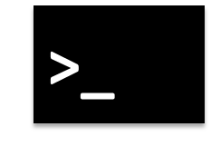
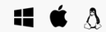


ML.NET Tooling + AutoML
Model Builder
ML.NET CLI
AutoML.NET API
(Microsoft.ML.AutoML)
ML.NET API
(Microsoft.ML)
Phase 1.1

Slide 31
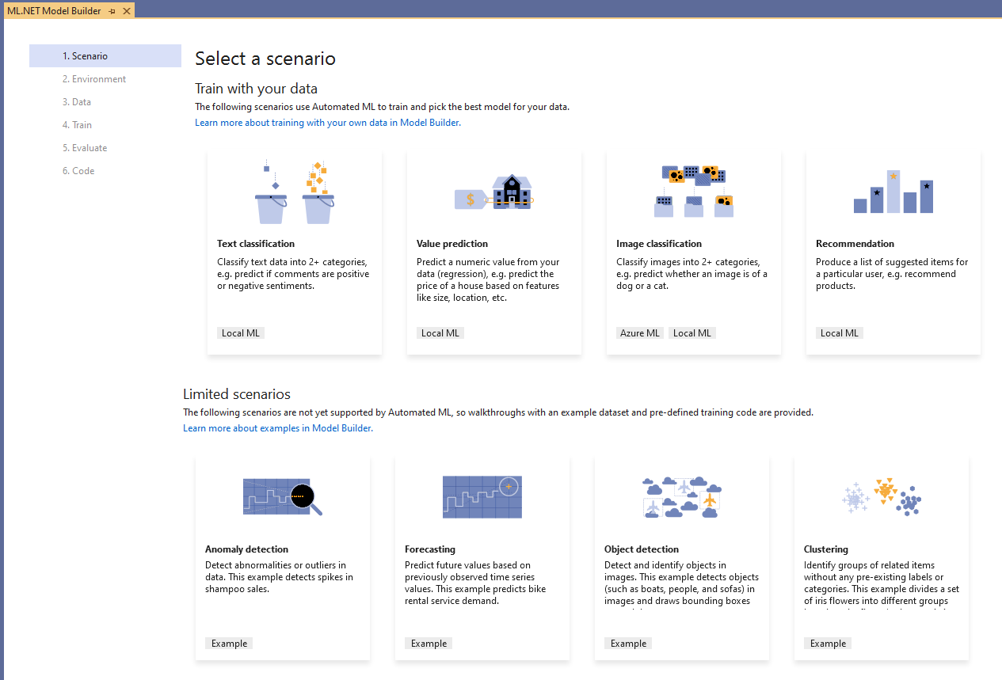
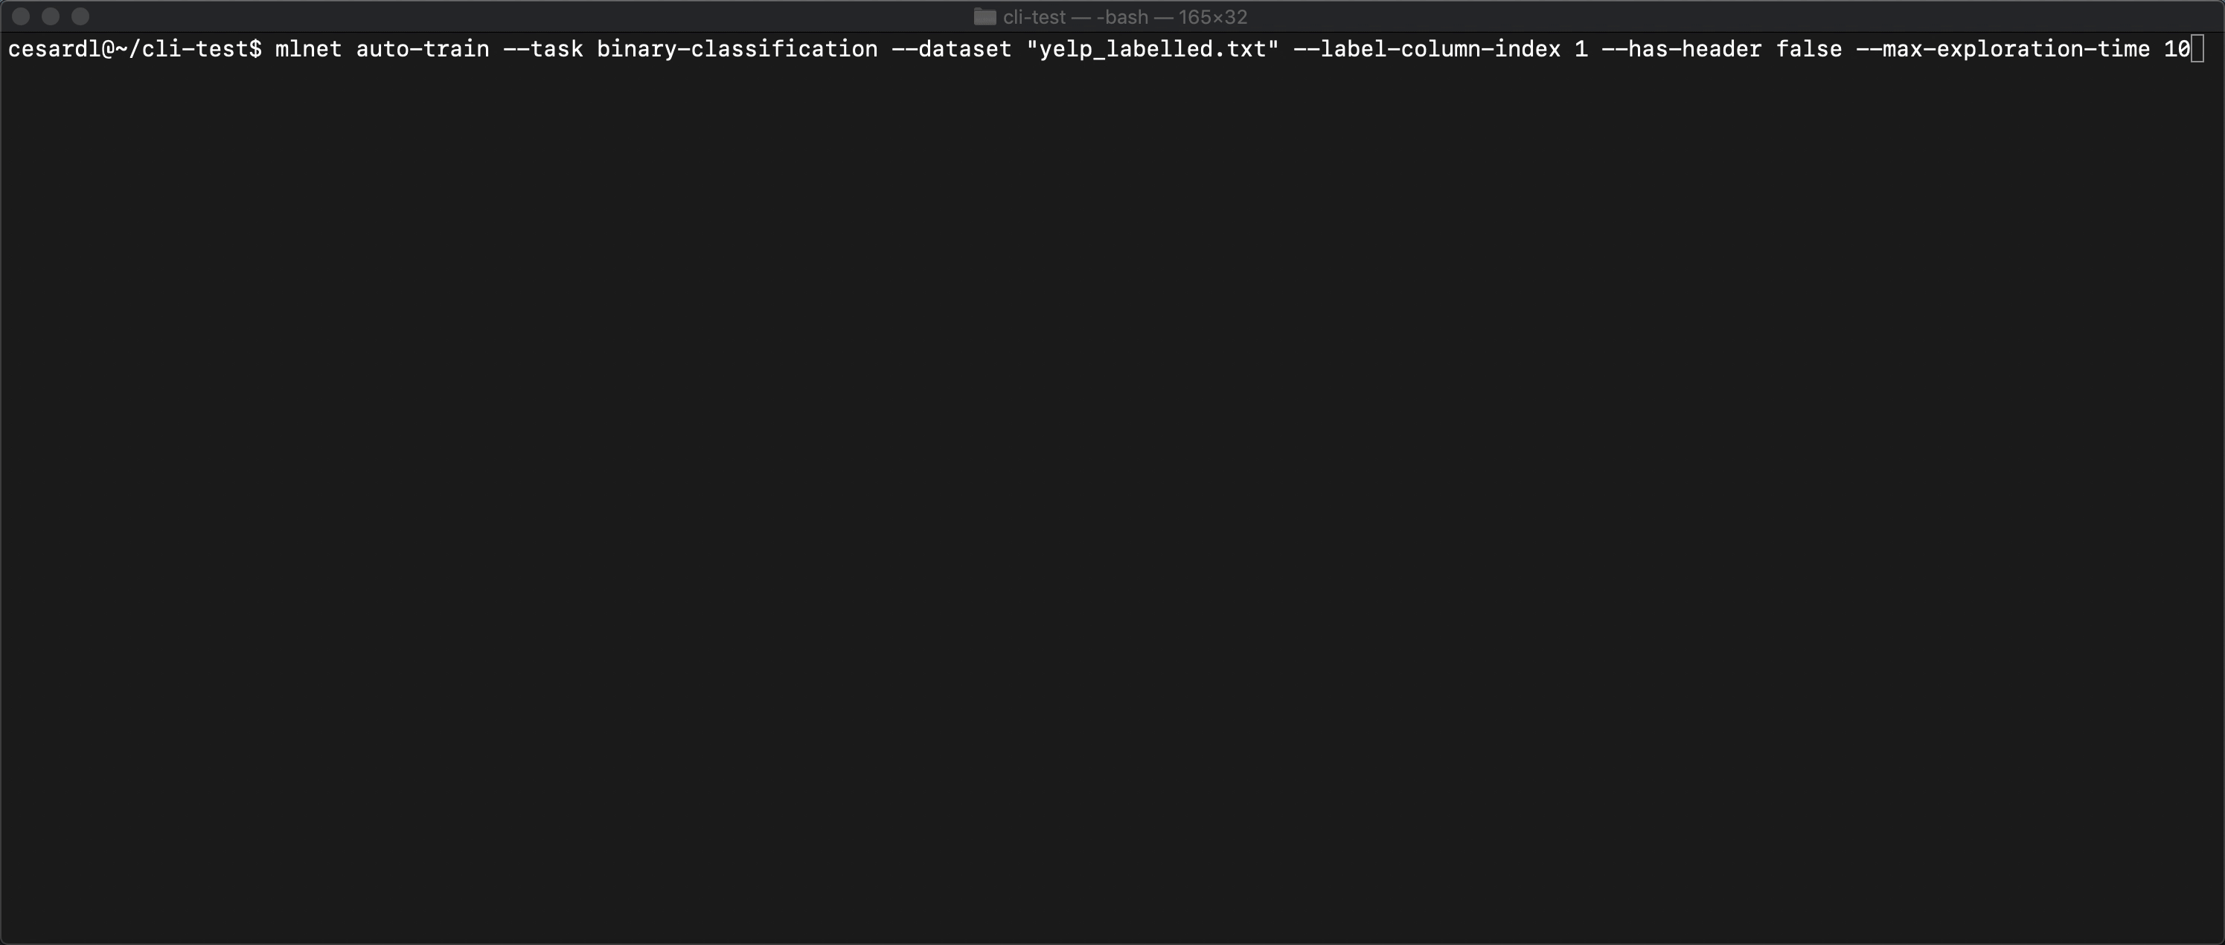
Model Builder & ML.NET CLI
Easily build custom ML models with AutoML
Generates code for training and consumption
Model Builder
Currently in Visual Studio only (ships with VS 16.6)
Integration with Azure ML (image classification)
ML.NET CLI
Cross platform
Phase 1.1

Slide 32
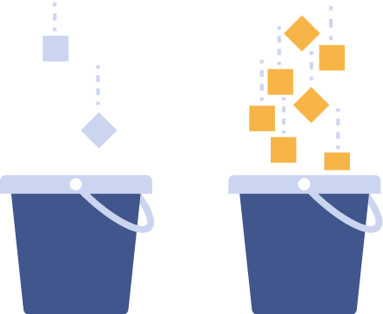
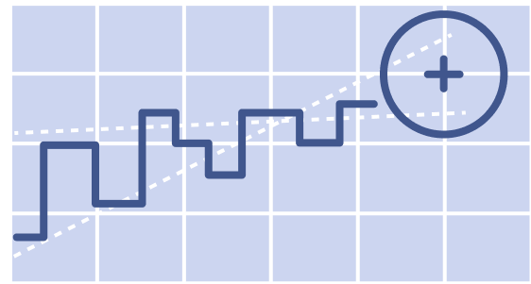
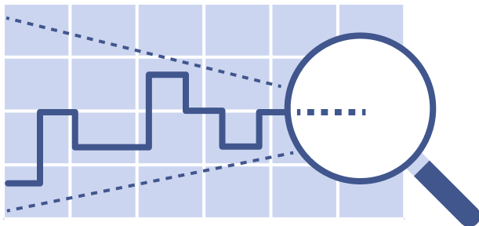






Supported ML tasks in ML.NET
Classification
Regression
Forecasting
Anomaly detection
Image classification
Ranking
Clustering
Recommendation
Object detection
Phase 1.1
Notes:
Classification – sentiment analysis, Categorizing e-mail as spam or not spam, classify law documents
Regression – price prediction, predict sales of product based on advertising budgets
Forecasting - Predicting future sales based on past sales, Predictive maintenance, Weather forecasting
Anomaly detection - Identifying transactions that are potentially fraudulent., Learning patterns that indicate that a network intrusion has occurred., Finding abnormal clusters of patients., Checking values entered into a system.

Slide 33

Integration with other ML tech @ Microsoft
Azure Cognitive Services – Custom Vision
Train
Image classification or object detection
Export
To ONNX
Consume
In .NET app using ML.NET
Azure Cognitive Services
(Custom Vision)
Phase 1.1

Slide 34

Integration with other ML tech @ Microsoft
Azure Machine Learning
Start in Model Builder
Choose Scenario, Training Environment, & Data
Train
Using Azure AutoML
Consume
In .NET app using Model Builder & ML.NET
Model Builder in VS
Azure ML
Phase 1.1

Slide 35
Integration with other ML tech @ Microsoft
WinML
Train
Using ML.NET
Export
To ONNX
Consume
With WinML in Windows Desktop Apps
WinML
Phase 1.1

Slide 36
When should you use ML.NET?
When you…
Want to stay in .NET ecosystem for Machine Learning
Don’t want to worry about low-level complexities of ML
Want to train a custom model
Want to consume a pre-trained model
Phase 1.1

Slide 37
Phase 1.2 Challenge: Build a Machine Learning model in 3 minutes or less

Slide 38
Challenge
aka.ms/phase-1-2
Using ML.NET Model Builder or the ML.NET CLI and the given e-commerce dataset (flipkart_com-ecommerce_sample.csv), create a model that classifies e-commerce products into categories
Make sure you train AND use the model to make predictions in a .NET app
Hint: Train for at least 40 seconds
Phase 1.2
Notes:
Dataset: (flipkart_com-ecommerce_sample.csv)

Slide 39
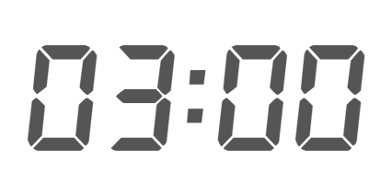

Slide 40
Phase 1.2 Challenge Review
Notes:
https://github.com/luisquintanilla/mlnet-workshop-guide/blob/172620570512c5a458a8f1ea391ef4e14d568e91/src/TrainConsole/Program.cs#L15-L17

Slide 41
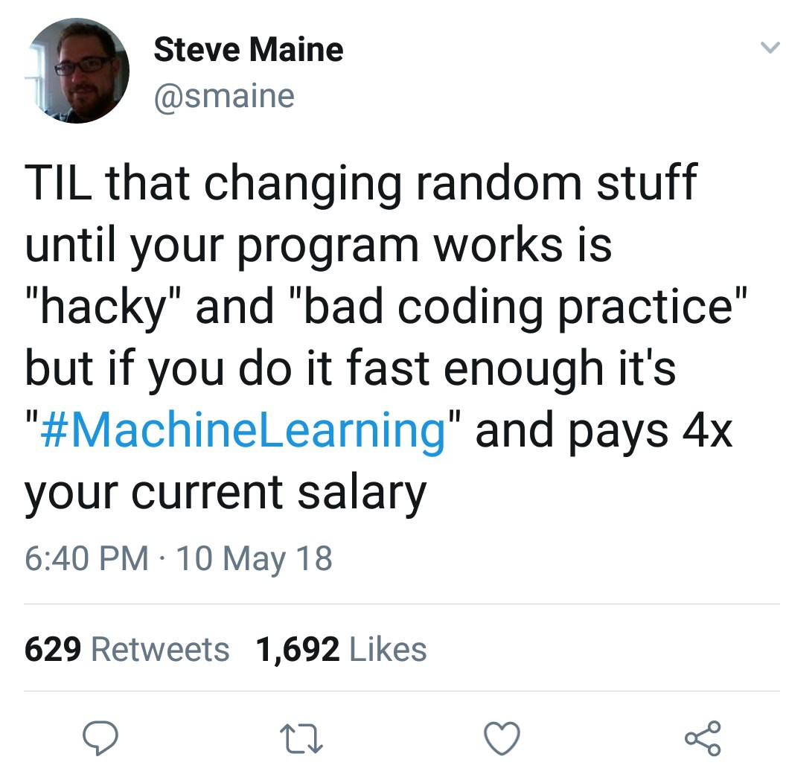
15 minute Break

Slide 42
Phase 2.0 Set up for ML.NET

Slide 43
Problem to solve: Car price prediction
aka.ms/mlnet-workshop
We will create a web app that allows users to input in data about their car (year, make, model, mileage) and returns how much their used car is worth.
Regression task (value prediction scenario)
App details:
Train regression model in .NET core console app with given dataset
Consume model in ASP.NET Core web app
Phase 2.0

Slide 44
ML.NET NuGet Packages
Most scenarios
Microsoft.ML
Forecasting & anomaly detection scenarios :
Microsoft.ML.TimeSeries
Recommendation scenario:
Microsoft.ML.Recommender
Database loader
System.Data.SqlClient
Consuming ONNX models:
Microsoft.ML.ONNXTransformer (+ Microsoft.ML.ImageAnalytics for object detection)
Consuming TensorFlow models:
Microsoft.ML.TensorFlow + SciSharp.TensorFlow.Redist (+ Microsoft.ML.ImageAnalytics for image classification)
Train custom image classification models:
Microsoft.ML.Vision + Microsoft.ML.ImageAnalytics + SciSharp.TensorFlow.Redist
Phase 2.0

Slide 45
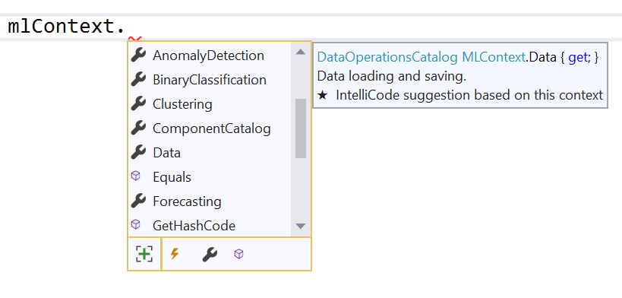
MLContext
MLContext = starting point for all ML.NET operations
Provides ways to create components for
Data preparation
Feature engineering
Training
Prediction
Model evaluation
Logging
Execution control
Seeding
Phase 2.0
Notes:
https://github.com/dotnet/machinelearning/blob/master/docs/code/MlNetHighLevelConcepts.md#mlcontext

Slide 46
Task
aka.ms/phase-2-0
Make sure to clone the repo aka.ms/mlnet-workshop
Add the Microsoft.ML NuGet package to your console project
Initialize a new MLContext in your console app
Phase 2.0

Slide 47
Phase 2.1 Data

Slide 48


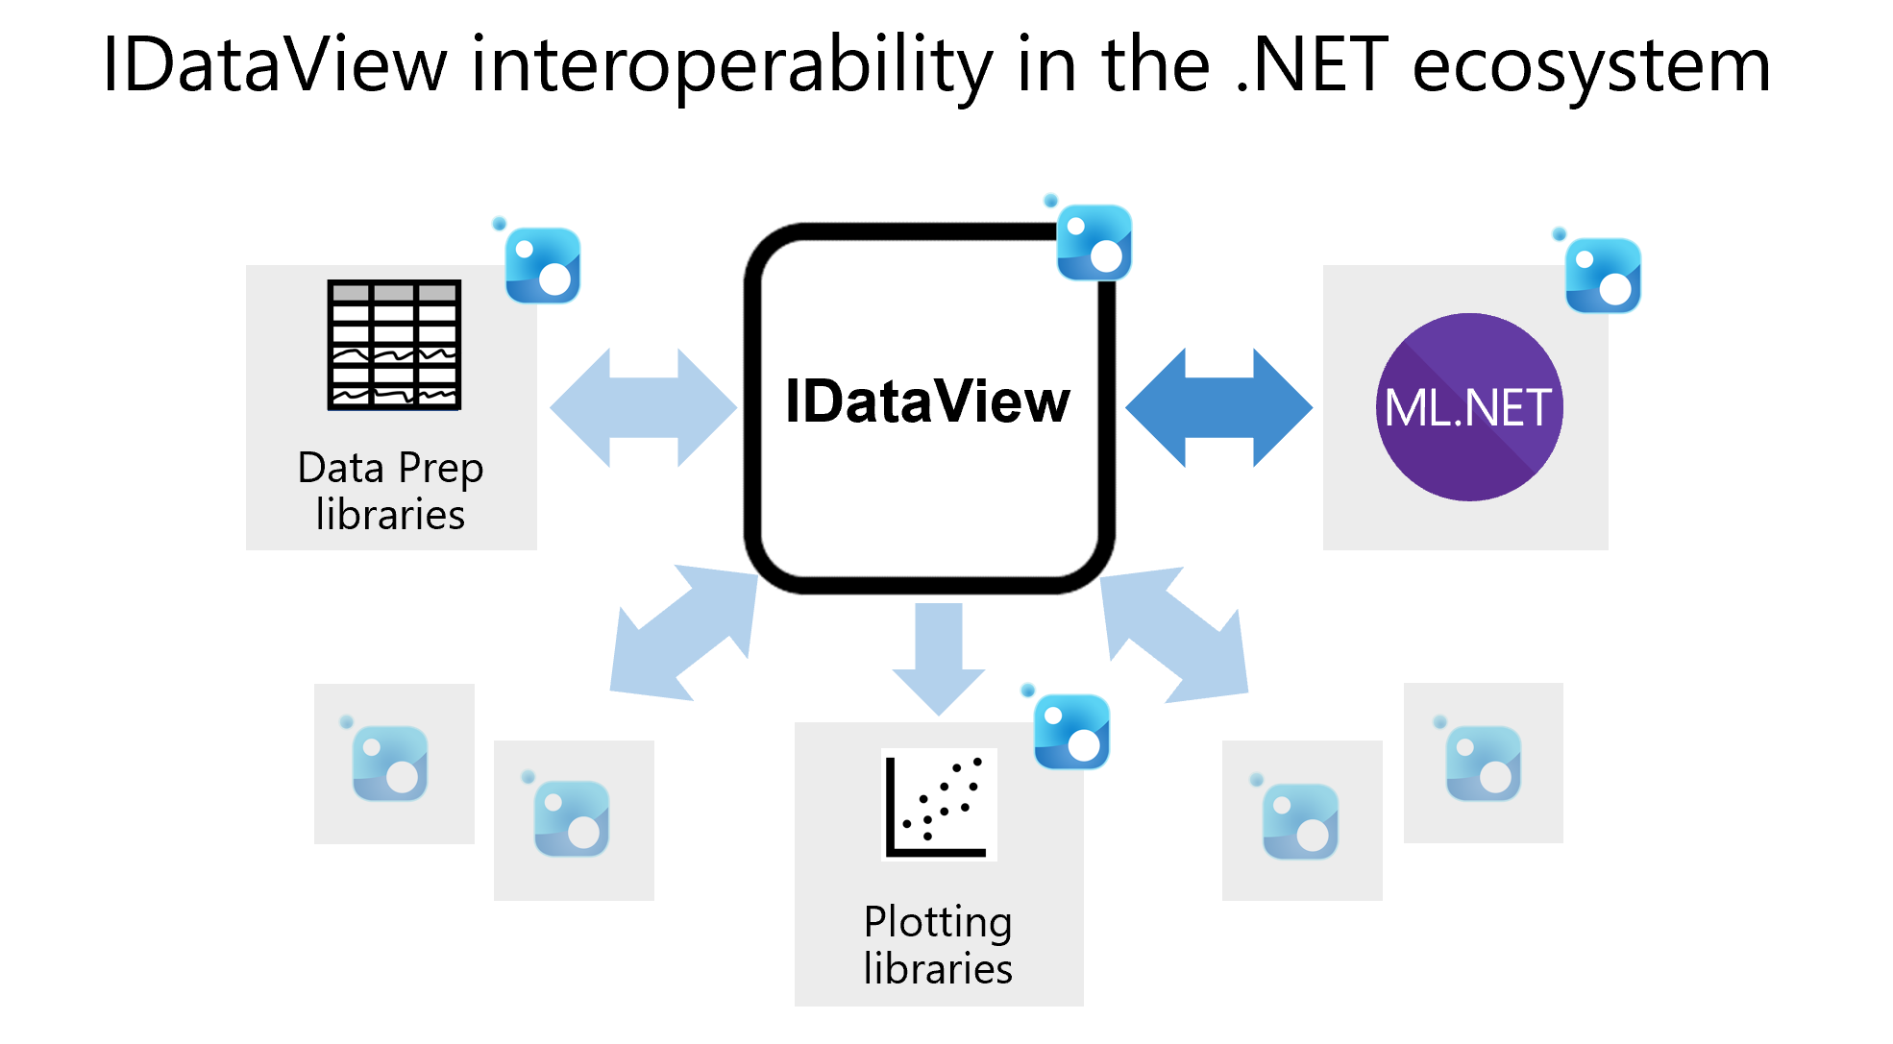
IDataView
Data in ML.NET represented as IDataView
High-dimensional
Lazy + memory efficient
Immutable
Phase 2.1
Notes:
IDV = Flexible, efficient way of describing tabular data
The IDataView component provides a very efficient, compositional processing of tabular data (columns and rows) especialy made for machine learning and advanced analytics applications. It is designed to efficiently handle high dimensional data and large data sets. It is also suitable for single node processing of data partitions belonging to larger distributed data sets.
Immutable – can’t change it – have to create a copy – not directly accessing the idv and changing it – making new copy of it
Lazy – as needed go through it, not all in memory
https://github.com/dotnet/machinelearning/blob/master/docs/code/IDataViewDesignPrinciples.md

Slide 49
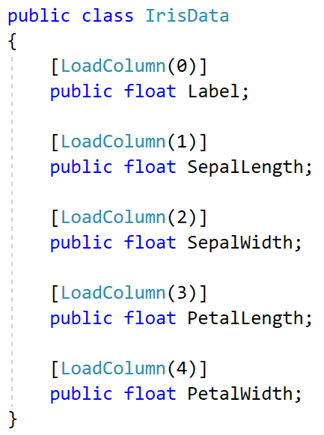
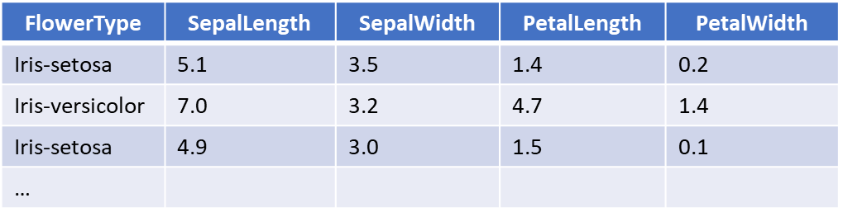
Data schema
DataViewSchema = Data schema of IDataView = set of columns, their names, types, & other annotations
Before loading data, must define how schema of data will look (column names & column types)
Use class definitions to define IDV schemas
Class definition of schema
IDataView
Dataset
Label | SepalLength | SepalWidth | PetalLength | PetalWidth
Iris-setosa | 5.1 | 3.5 | 1.4 | 0.2
Iris-versicolor | 7.0 | 3.2 | 4.7 | 1.4
Iris-setosa | 4.9 | 3.0 | 1.5 | 0.1
…
Phase 2.1
Notes:
FlowerType is what we’re trying to predict. This becomes the Label property. This Label is the label or target variable. In an IDataView the column names are the names of the properties. The way in which data is loaded is determined by LoadColumn which specifies the index where to find that data point in the file.
https://github.com/dotnet/machinelearning/blob/master/docs/code/IDataViewDesignPrinciples.md
https://github.com/dotnet/machinelearning/blob/master/docs/code/SchemaComprehension.md

Slide 50
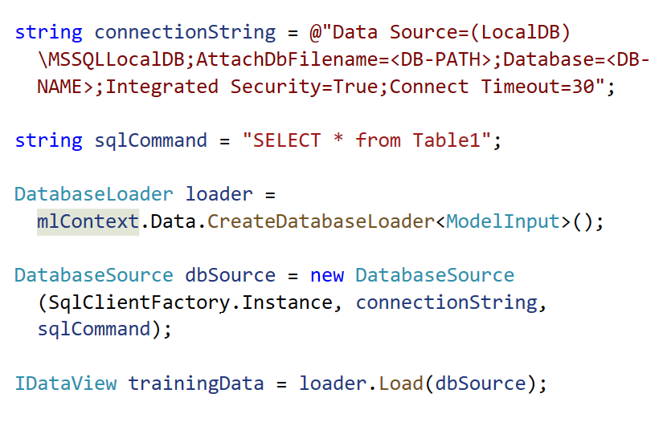
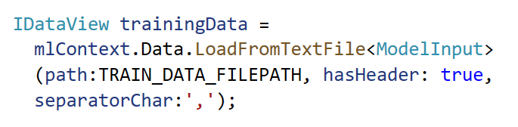
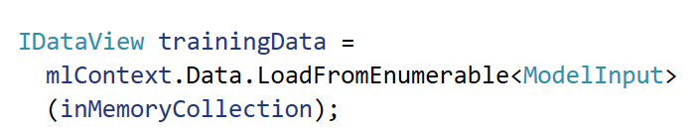
Data loaders & sources
File loaders
Database loaders
Other sources
Load data from sources like text, binary, and image files to IDV
Can load from single or multiple files
Supported:
Text: .csv, .tsv, .txt
Images: .png, .jpg, .bmp
Load and train data directly from relational database
Supports:
SQL Server, Azure SQL Database, Oracle, SQLite, PostgreSQL, Progress, IBM DB2, + many more
Load from Enumerable (in-memory collections)
Supports:
JSON/XML
Everything else
Phase 2.1

Slide 51
Task
aka.ms/phase-2-1
Create class for Model Input based on the provided car listing dataset
Load data from file to IDataView
Phase 2.1

Slide 52
Phase 2.1 Task Review
Notes:
https://github.com/luisquintanilla/mlnet-workshop-guide/blob/172620570512c5a458a8f1ea391ef4e14d568e91/src/TrainConsole/Program.cs#L15-L17

Slide 53
Phase 2.2 Training
Notes:
-Talk about the most common transforms
-Break down featurize text (convenience API for text data), maybe normalize minmax
-Talk about different algos for ML tasks -- iterative, experimental process -- don't know what will work, try all of them (or use AutoML)
-Briefly talk about algo options
-Fit method, lazy loading, what's happening when you call Fit()
-ITransfomer + IEstimator --- Fit() returns model, which is an Itransformer
-algo has pre-defined / default columns for input -- you can change those names if you want / how
-onnx export (sometimes)

Slide 54




Preparing your data
Filter data
Split data
Feature engineering
Convert data types
Normalize the data
Phase 2.2

Slide 55


IEstimator and ITransformer
IEstimator
ITransformer
Phase 2.2
Notes:
https://docs.microsoft.com/en-us/dotnet/machine-learning/resources/transforms#feature-transformations
https://docs.microsoft.com/en-us/dotnet/machine-learning/resources/transforms#feature-transformations
Estimators and transformers: https://github.com/dotnet/machinelearning/blob/master/docs/code/MlNetHighLevelConcepts.md#transformer
https://github.com/dotnet/machinelearning/blob/master/docs/code/MlNetHighLevelConcepts.md#estimator
Estimators
Untrained transformer
Definition of the operations that are to take place
Transformers
Component that realizes the transformations defined by the estimators

Slide 56
Data transforms
Normalization
Min-Max
Binning
Missing Values
Indicate
Replace
ColumnMapping
Concatenate
Type Conversion
Text Transforms
Drop columns
Featurize text
Remove stop words
Map value to key
Hash
Mean variance
Copy columns
Convert type
N-grams
Word bags
Phase 2.2
Notes:
https://docs.microsoft.com/en-us/dotnet/machine-learning/resources/transforms#feature-transformations

Slide 57
Algorithms / Trainers
Trainer = Algorithm + Task
Algorithm
Example: Stochastic Dual Coordinated Ascent (SDCA)
Binary classification
Multi-class classification
Regression
Task
Trainer
SdcaNonCalibrated
BinaryTrainer
SdcaNonCalibratedMulti
classTrainer
SdcaRegressionTrainer
Phase 2.2
Notes:
With ML.NET, the same algorithm can be applied to different tasks. For example, Stochastic Dual Coordinated Ascent can be used for Binary Classification, Multiclass Classification, and Regression. The difference is in how the output of the algorithm is interpreted to match the task.
https://docs.microsoft.com/en-us/dotnet/machine-learning/how-to-choose-an-ml-net-algorithm

Slide 58

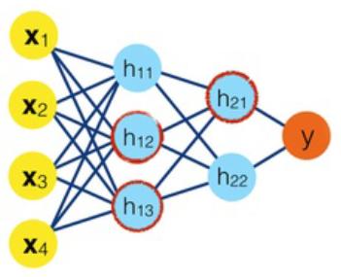
Training pipeline
IEstimatorChain = Collection of Data Transforms + Algorithms
Drop columns
Normalize
Naïve Bayes Algorithm
IDataView
IEstimatorChain
Model
Phase 2.2

Slide 59
Fit() the model
Pipeline executed when Fit() method is called
ITransformer model = pipeline.Fit(trainingData)
Phase 2.2
Notes:
https://github.com/dotnet/machinelearning/blob/master/docs/code/MlNetHighLevelConcepts.md#prediction-function

Slide 60
Task
aka.ms/phase-2-2
Split data into train and test datasets
Add data transformations to the pipeline
Choose an algorithm and add to the pipeline
Train the model
Phase 2.2

Slide 61
Phase 2.2 Task Review
Notes:
https://github.com/luisquintanilla/mlnet-workshop-guide/blob/e6f0ebf11b72c629a269af4bce646dca585a3280/src/TrainConsole/Program.cs#L19-L36

Slide 62
Phase 2.3 Evaluate your model

Slide 63
Evaluation metrics
ML Task | Most common evaluation metric | Look for
Classification | Binary: Accuracy Multi-class: Micro-Accuracy | Closer to 1.0, the better the quality
Regression | R-Squared | Closer to 1.0, the better the quality
Recommendation | R-Squared | Closer to 1.0, the better the quality
Clustering | Average Distance | Values closer to 0 are better.
Ranking | Discounted Cumulative Gains | Higher values are better
Anomaly detection | Area Under ROC Curve | Values closer to 1 are better.
Phase 2.3
Notes:
https://docs.microsoft.com/en-us/dotnet/machine-learning/how-to-guides/train-machine-learning-model-ml-net

Slide 64
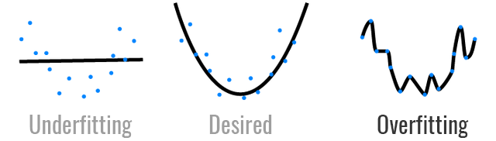
Underfitting & Overfitting a model
Underfitting
Model is too simple and can’t capture the underlying trend of the data
Overfitting
Model doesn’t generalize well from training data to unseen data
To prevent:
Feature engineering
Remove noise from data
Try different algorithms
To prevent:
More training data
Remove features
Cross validation
Phase 2.3
Notes:
A statistical model or a machine learning algorithm is said to have underfitting when it cannot capture the underlying trend of the data. Its occurrence simply means that our model or the algorithm does not fit the data well enough..
The word overfitting refers to a model that models the training data too well. Instead of learning the genral distribution of the data, the model learns the expected output for every data point.
This is the same a memorizing the answers to a maths quizz instead of knowing the formulas. Because of this, the model cannot generalize. Everything is all good as long as you are in familiar territory, but as soon as you step outside, you’re lost.
Overfitting can be pretty discouraging because it raises your hopes just before brutally crushing them.
https://docs.microsoft.com/en-us/dotnet/machine-learning/how-to-guides/train-machine-learning-model-ml-net

Slide 65
Cross validation
Training and model evaluation technique
Folds the data into n-partitions and trains multiple algorithms on these partitions
Improves robustness by holding out data from training process
Partition 1 | Partition 2 | Partition 3 | Partition 4 | Partition 5
Phase 2.3
Notes:
https://docs.microsoft.com/en-us/dotnet/machine-learning/how-to-guides/train-machine-learning-model-cross-validation-ml-net
https://github.com/dotnet/machinelearning/blob/master/docs/code/MlNetCookBook.md#how-do-i-train-using-cross-validation

Slide 66
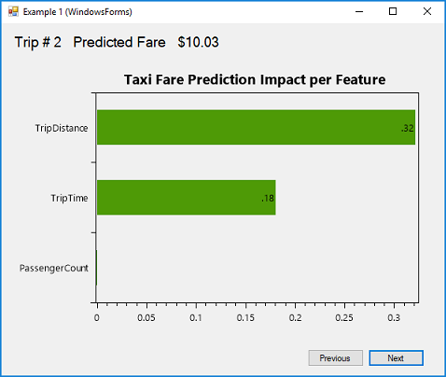
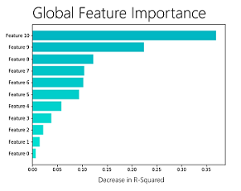
Model explainability
Global and local explanations
Global = entire model (What features does the model give more importance to?)
Local = individual predictions (Why was Bob rejected for a loan?)
Techniques:
Permutation Feature Importance (PFI)
Used for Classification and Regression models
Shuffles data one feature at a time and calculates how much the performance metric of interest decreases; the larger the change, the more important the feature
Feature Contribution Calculation (FCC)
Used for Classification and Regression models
Shows which features are most influential for a model’s prediction on a particular and individual data sample
Phase 2.3
Notes:
PFI measures feature importance by asking the question, “What would the effect on the model be if the values for a feature were set to a random value (permuted across the set of examples)?”
FCC works by determining the amount each feature contributed to the model’s score for that particular data sample
https://docs.microsoft.com/en-us/dotnet/machine-learning/how-to-guides/explain-machine-learning-model-permutation-feature-importance-ml-net
https://github.com/dotnet/machinelearning/blob/master/docs/code/MlNetCookBook.md#i-want-to-look-at-my-models-coefficients
https://github.com/dotnet/machinelearning/blob/master/docs/code/MlNetCookBook.md#i-want-to-look-at-my-models-coefficients
https://github.com/dotnet/machinelearning/blob/master/docs/code/MlNetCookBook.md#i-want-to-look-at-my-models-coefficients
https://github.com/dotnet/machinelearning/blob/master/docs/code/MlNetCookBook.md#how-do-i-look-at-the-local-feature-importance-per-example

Slide 67
Improving your model
Provide more training data
Filter missing values and outliers
Feature engineering
Select different features
Choose a different algorithm
Tune algorithm hyperparameters
Cross validation
Phase 2.3

Slide 68
Tooling + AutoML
Use AutoML to speed up the experimentation process
Use Model Builder in VS or cross-platform ML.NET CLI
ML Task | Tooling | Local / Azure AutoML
Text-based classification | Model Builder, CLI | Local
Value prediction (Regression) | Model Builder, CLI | Local
Image classification | Model Builder | Local + Azure
Recommendation | Model Builder, CLI | Local
Phase 2.3

Slide 69
Task
aka.ms/phase-2-3
Evaluate your model and print out the R-Squared metric
Optional: Try training with different algorithms to see if your evaluation metrics change
Phase 2.3

Slide 70
Phase 2.3 Task Review
Notes:
https://github.com/luisquintanilla/mlnet-workshop-guide/blob/783f770dc7044386e8089bb3dadcf85b43abf747/src/TrainConsole/Program.cs#L39-L52

Slide 71
Phase 2.4 Save your model

Slide 72
ML.NET Model
ML.NET
Model
=
Serialized zip file which contains data schemas, data transforms, and algorithms
MLModel.zip
Phase 2.4

Slide 73
Task
aka.ms/phase-2-4
Save your model to the same folder as your project
Phase 2.4

Slide 74
Phase 2.4 Task Review
Notes:
https://github.com/luisquintanilla/mlnet-workshop-guide/blob/5a650fa028346ee78611efa72acd582aac257e2a/src/TrainConsole/Program.cs#L55-L57

Slide 75
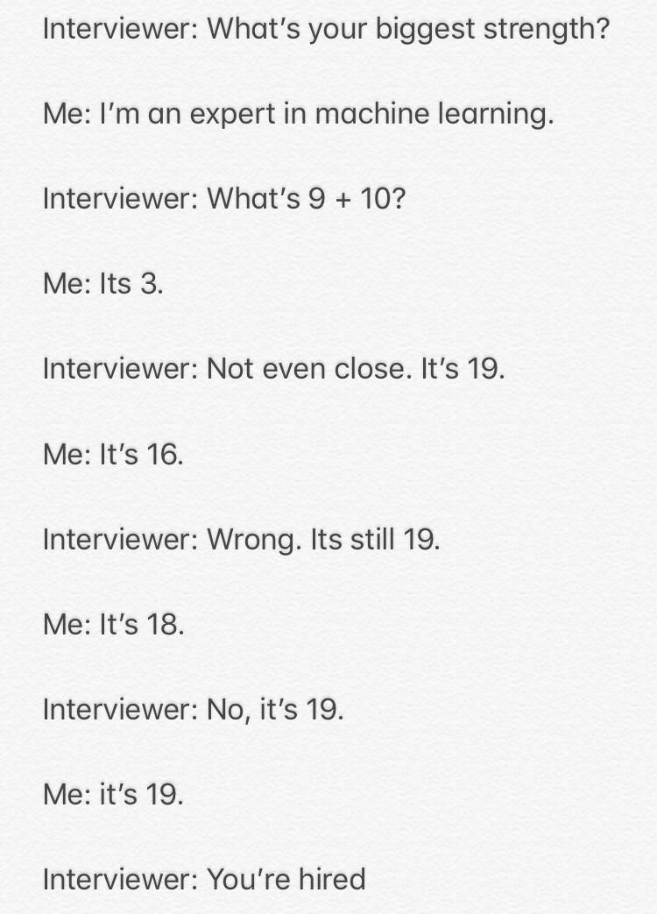
30 minute Break

Slide 76
Phase 3.0 Consume your model

Slide 77
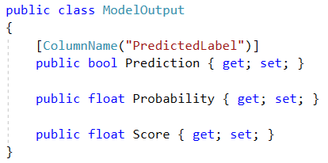
How to consume model in ML.NET
1. Create model output schema
Task | Model Output
Binary classification | Predicted Label: Class predicted by model (true or false) Score: Positive score = true, negative score = false Probability: Probability of having true as label
Multiclass classification | Predicted Label: Class predicted by model Score (vector): Scores of all classes; highest score = predicted label
Regression | Score: Predicted value
Recommendation | Score: Predicted rating
Clustering | Predicted Label: Closest cluster’s index predicted by model Score: Distances of data point to clusters’ centroid
Ranking | Score: Predicted rank
Anomaly detection | <Alert (Boolean), Raw Score, P-value (likelihood of anomaly)> OR Predicted Label: Anomaly vs. not anomaly predicted by model Score: Likelihood of anomaly
Forecasting | Forecasting values Confidence lower bounds Confidence upper bounds
Phase 3.0

Slide 78
How to consume model in ML.NET
2. Load your model
Phase 3.0

Slide 79
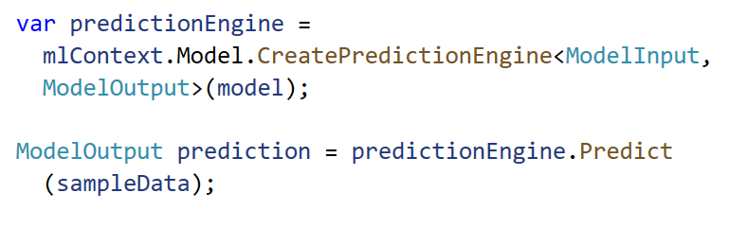
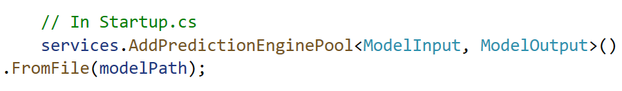
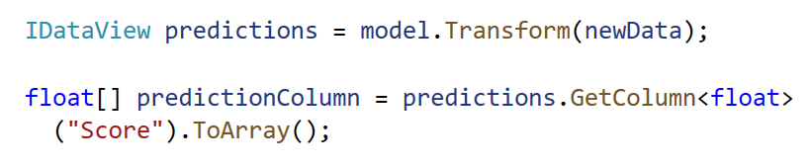
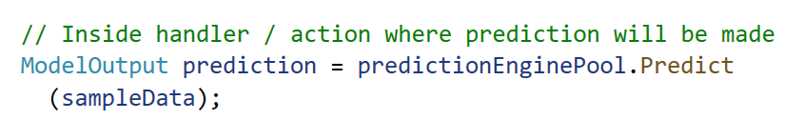
How to consume model in ML.NET
3. Choose one of the below:
Make single predictions
Prediction Engine
Make single predictions scalable
Prediction Engine Pool
Make batch predictions
Transform
Prediction Engine = convenience API for making single predictions
Prediction Engine not thread-safe
Use dependency injection + Prediction Engine Pool in multi-threaded apps (e.g. web apps and services)
Creates ObjectPool of PredictionEngine objects for application use
Takes in data, makes the transformations (such as, making predictions), and outputs the data
Can load unknown data into IDataView, use Transform to predict, receive IDataView of predicted values, and use GetColumn to get the Prediction column
Phase 3.0

Slide 80



Model deployment
Desktop
Web
Mobile
Phase 3.0

Slide 81
Task
aka.ms/phase-3-0
Load the model from a file to the web app
Create a Prediction Engine
Use the model and prediction engine to make predictions on new sample data (e.g. consume the model)
Phase 3.0

Slide 82
Phase 3.0 Task Review
Notes:
1. First, we installed the Microsoft.Extensions.ML NuGet package to
1. . Define Model Output Schema: https://github.com/luisquintanilla/mlnet-workshop-guide/blob/881ff8dac7d2293e82548573db6d1579f432915b/src/Shared/ModelOutput.cs#L5-L11
Then, we define the schema of the model output so we can access the predictions made
2. After that, we register the PredictionEnginePool engine service in our Startup.cs file just like we would any other service.
https://github.com/luisquintanilla/mlnet-workshop-guide/blob/881ff8dac7d2293e82548573db6d1579f432915b/src/Web/Startup.cs#L38
3. We then inject the PredictionEnginePool service in our Index PageModel
https://github.com/luisquintanilla/mlnet-workshop-guide/blob/881ff8dac7d2293e82548573db6d1579f432915b/src/Web/Pages/Index.cshtml.cs#L43
4. Finally, we use the PredictionEnginePool service in the OnPost method to make predictions
https://github.com/luisquintanilla/mlnet-workshop-guide/blob/881ff8dac7d2293e82548573db6d1579f432915b/src/Web/Pages/Index.cshtml.cs#L66

Slide 83
Phase 4.0 Deep learning

Slide 84

What are Neural Networks?
Phase 4.0

Slide 85
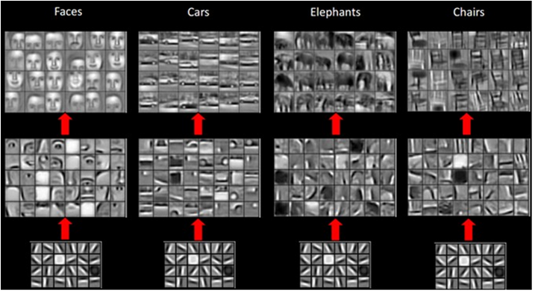
Neural Network Layers
This Photo by Unknown Author is licensed under CC BY-SA
Phase 4.0

Slide 86
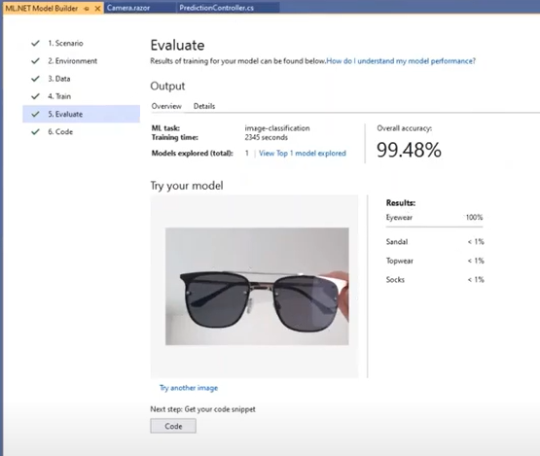
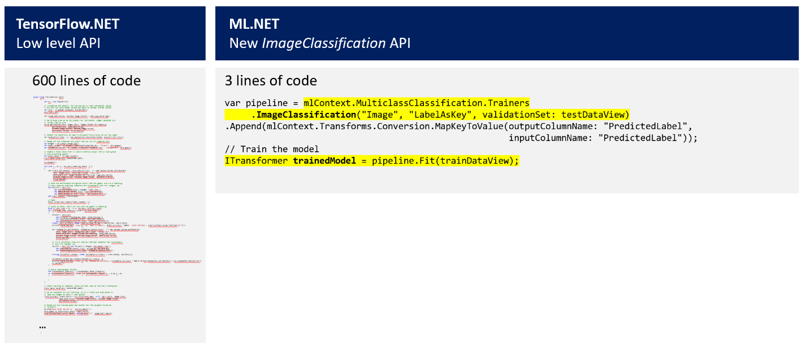
Deep learning in ML.NET
Model Consumption ML.NET API
Model Training Image Classification API
Model Training Model Builder in VS
Consume pre-trained TensorFlow and ONNX models
Train custom image classification models via Image Classification API
Uses transfer learning
Built on TensorFlow.NET
Can use local GPU for training
Train custom image classification models
Can train locally or in Azure (Azure ML)
Phase 4.0

Slide 87
Training Deep Learning Models in ML.NET
Architectures
MobileNet
Inception
Resnet
Phase 4.0

Slide 88
Additional Tasks
aka.ms/phase-4-0
Task 1: Local image training with Image Classification API
Task 2: Azure image training with ML.NET Model Builder
Phase 4.0

Slide 89
Phase 5.0 MLOps

Slide 90
What is ML Ops?
Machine Learning Operations (MLOps) applies DevOps principles & practices (e.g. continuous integration, delivery, and deployment) to the ML process
Phase 5.0

Slide 91
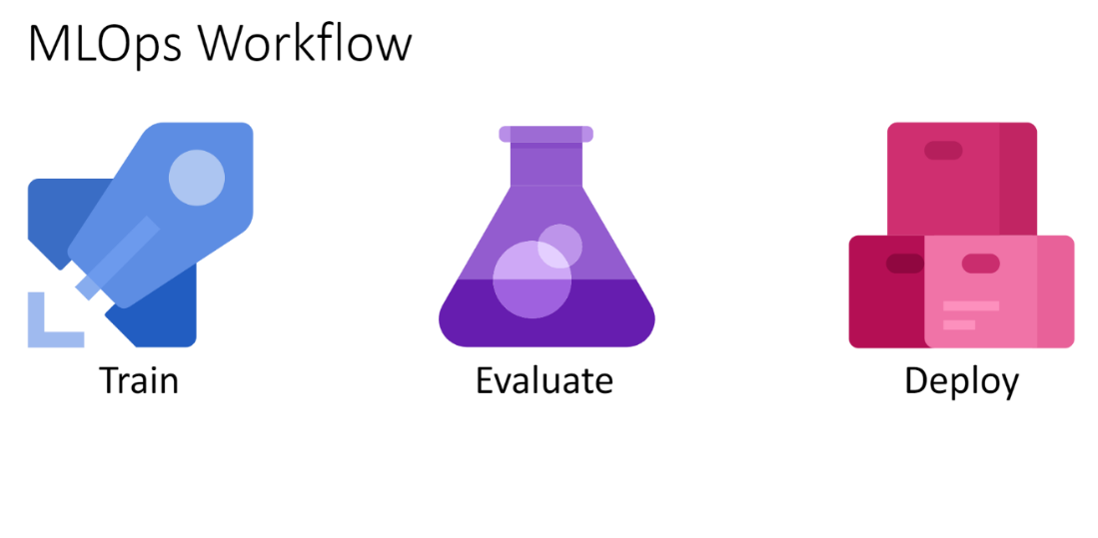
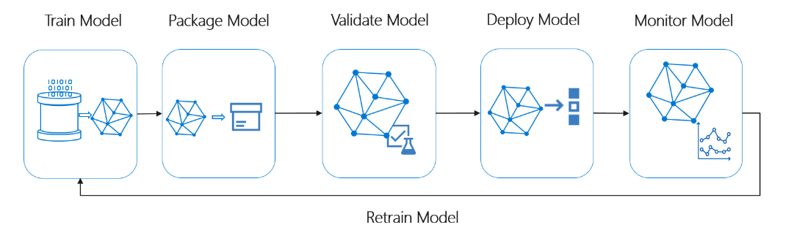
MLOps Workflow
Phase 5.0

Slide 92
Additional Tasks
aka.ms/phase-5-0
Task 1: Build a project that trains, tests, and deploys a sentiment analysis model.
Phase 5.0

Slide 93
Phase 6.0 Wrap-Up

Slide 94
ML.NET Roadmap
Text loader improvements
Local AutoML support for:
Time series forecasting
Anomaly detection
Ranking
Object detection training
Continued expansion of ONNX export support
Tooling (Model Builder and ML.NET CLI)
Support for all local AutoML and Azure AutoML supported scenarios via tooling
Advanced options (e.g. column type selection) in Model Builder
GPU training (local image classification)
Re-entrancy in Model Builder
MLOps integration
Improved / simplified CLI commands and options
Phase 6.0

Slide 95
Q&A

Slide 96


Resources
@briacht
@ljquintanilla
Get started at http://dot.net/ml
Try the samples at http://aka.ms/mlnetsamples
Read the docs at http://aka.ms/mlnetdocs
Watch ML.NET videos at https://aka.ms/mlnetyoutube
Request features or contribute at http://aka.ms/mlnet

